Slide 1
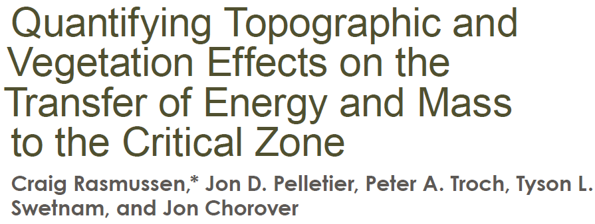
Vadose Zone Journal
Soil Science Society of America
Thermodynamics and mass-balance in natural systems
in a burn area
Keep in mind: authors are looking to show that energy is affected by slope & aspect;
that energy can predict soil depth;
that energy is strongly related to plants

Slide 2
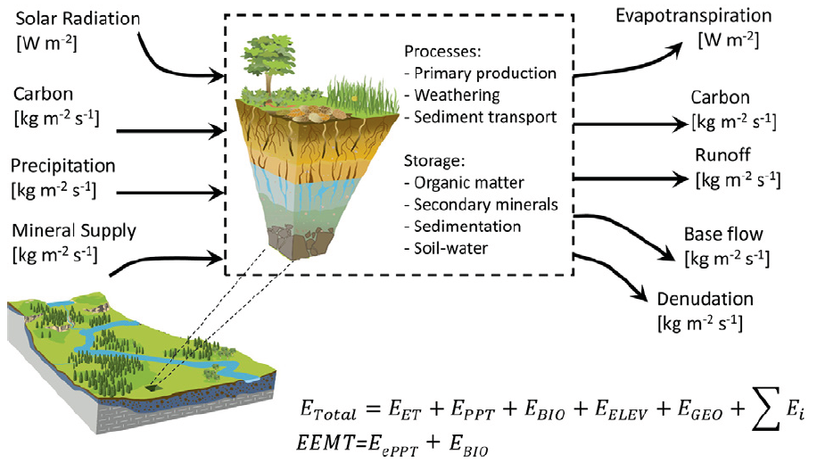
Quantifying several inputs and outputs to the critical zone for
Water, carbon, minerals and energy

Slide 3
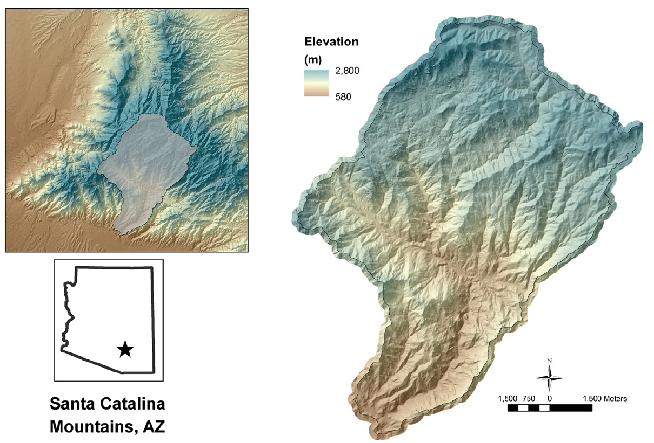
Sabino Canyon, AZ

Slide 4
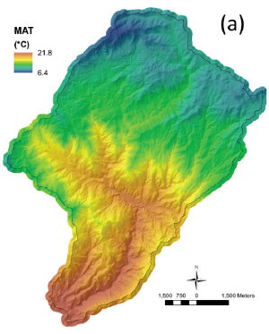
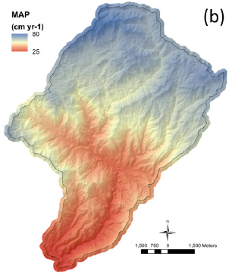
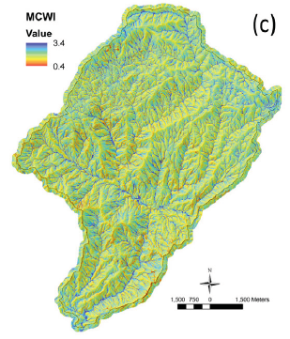
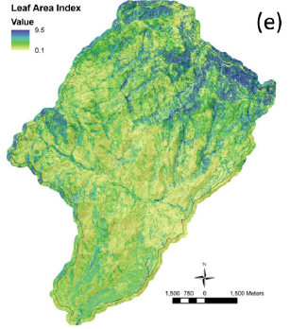
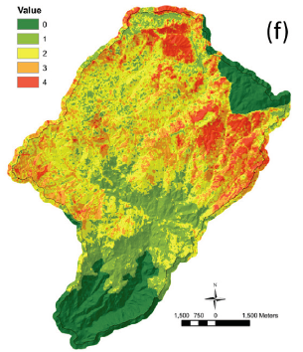
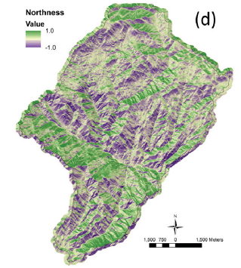

Slide 5
General qualities of the CZ to be quantified:
Energy: specific enthalpy, specific heat
Specific heat: J/kg*K
Specific enthalpy: J/kg
Biomass:
NDVI, LAI
Water
Precipitation => flow-routed effective precipitation
Notes:
Plants effect temperature and energy
Lapse rate is temperature as a function of elevation, 2 C per 1000 feet

Slide 6
Energy
Notes:
Eelev is potential energy of sediment by gravity
Egeo chemical and physical weathering
SumEi any other external energy not in other variables: dust,

Slide 7
Energy and EEMT
What does EEMT stand for?
Effective energy and mass transfer
What are the units?
W/ m²
p. 3, between equations 2 & 3
Define EEMT: the portion of energy into the subsurface that is important over relatively short time scales, from water that doesn’t run off or transpire and remains in plant material

Slide 8
What does topography impart to the energy balance?
What vegetation impart to the energy balance?

Slide 9
F = Flux water, specific heat water, Temperature
C_{w} = Specific heat of water
T = Temperature

Slide 10
Temperature?
NDVI = NIR – Red
NIR + Red
Light intensity at these wave lengths
from satellite imagery (NAID)
LAI = 18.99 x³ – 15.24 x² + 6.124x - .352; where x is NDVI.
Qi et al., 2000
LAI range: 0.1 – 9.5
C =1, b - basestation
T for EEMT_{trad}
T for EEMT_{topo}
T for EEMT_{topo-veg}

Slide 11
What to do with water exchange before entering subsurface?
F is subsurface wetting;
P_{eff} = PPT - AET
Getting to Mass conservative wetness index MCWI:
Types of EEMT (trad, topo & veg) are different in water
by how PET (or AET) vs PPT is estimated.

Slide 12
“AET” estimated above with different PET, PET details are in Supplement
_{es} is sat. vapor
pressure (eqn.)
AET for EEMT_{trad}
AET for EEMT_{topo}
PET of a pan – no plants
AET for EEMT_{topo-veg}
Includes a canopy height effect

Slide 13
Topographic Water distribution
To determine subsurface wetting (F) , include a factor that partitions moisture into hollows
Topographic wetness index, using a
surface flow estimate that concentrates
water with topography
Beven and Kirkby, 1979
F at a pixel is Fi,

Slide 14
Biomass
Net Primary Productivity
Canopy height (h) calculated from LiDAR data

Slide 15
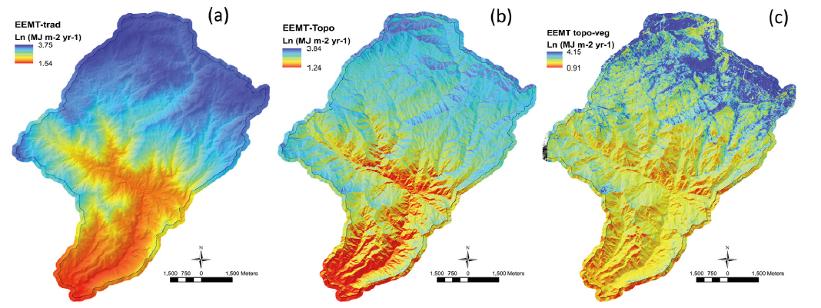
Section called Effective Energy and Mass Transfer (p. 9) provides a good summary.
How do different EEMT calculations change results?
First result: EEMT is strongly related to aspect due to radiation affect on soil moisture

Slide 16
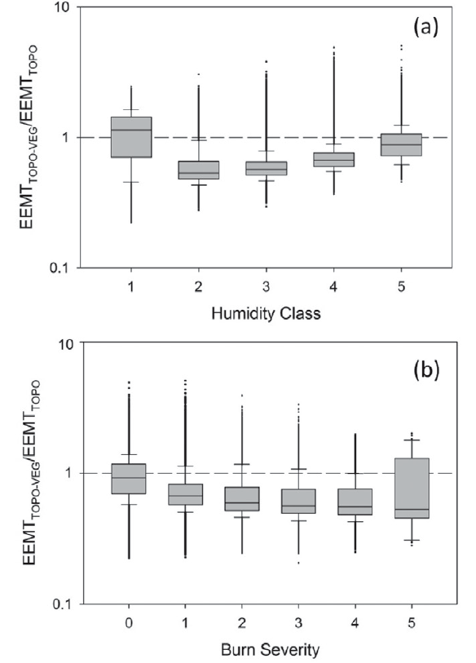
Comparing topo-veg and topo
What is humidity class?
How does “humidity class” change
EEMT estimates?
How does burn severity change
EEMT estimates?

Slide 17
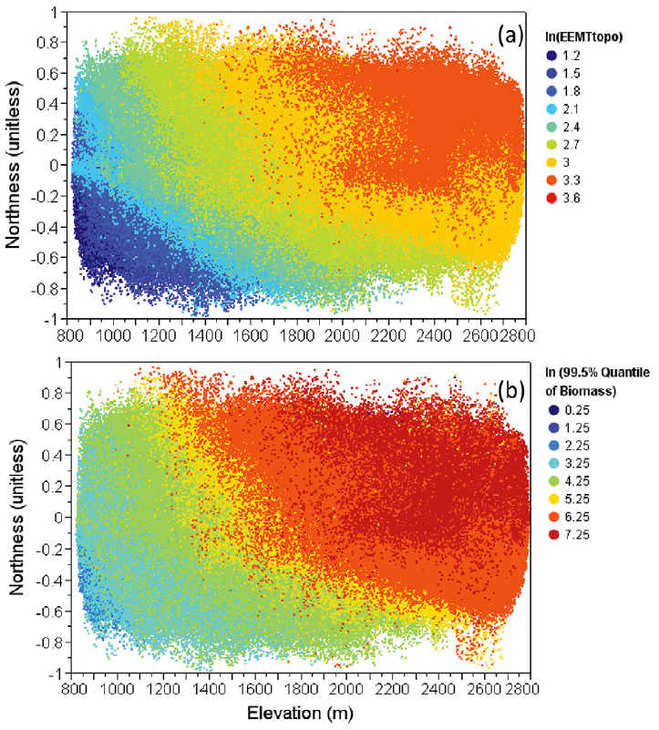

Slide 18
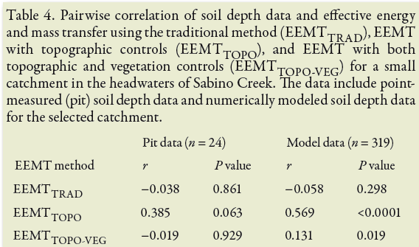
Is soil depth correlated with EEMT?
Why no graph or data table?
Does significant burn area
play a part in these correlation
differences?
Low P values, < 0.05, suggest a <5% probability that hypothesized correlation is false,
the null hypothesis (that correlation is zero) can be rejected.
High P values, near 1, can be interpreted that the hypothesized correlation is invalid.
93% probability topo veg does not predict soil depth.
R² for EEMT topo vs Soil Depth data is 0.148.

Slide 19
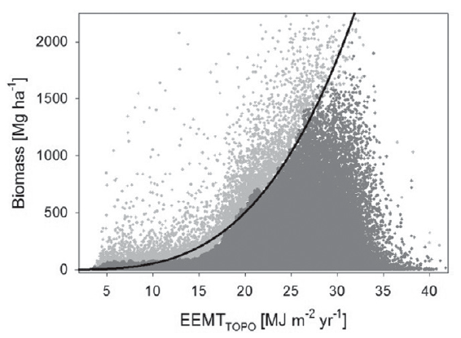
What does it mean to have an equation drawn on the 95% quantile?

Slide 20
Conclusions
1
EEMT is affected by northness as much as a 300 m elevation change
2
“long term-term average energy and mass influx, vs current veg controlled state”
EEMT topo vs EEMT topo-veg
AGB and EEMT topo
“a power law relationship was observed between
aboveground biomass and EEMT topo”
3
4
EEMT “effective predictor of CZ properties”

Slide 21
Supplement Table 1.

